Slide 1
Comorbidity of diabetics with helminth infection
Rahul Biswas(CS18S008)
Sai Kumar(CS18S003)

Slide 2
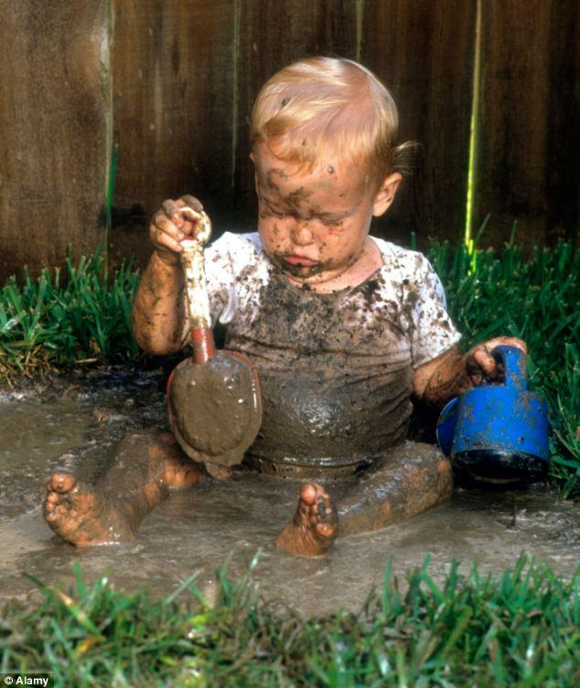
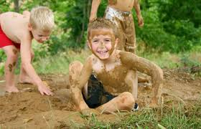
Should you let your baby play in dirt and not bother cleaning the house?

Slide 3
GOAL OF THE PROJECT
Identifying the role of helminth infection in reducing the risk of diabetics
Building a multiclass classification model
Finding the features which are important in predicting the double disease cases exclusively
Helminths are multicellular organisms that have developed a wide range of strategies to manipulate the host immune system.
Immunity to helminths involves profound changes in both the innate and adaptive immune compartments,which can have a protective effect in inflammation and autoimmunity.
https://www.ncbi.nlm.nih.gov/pmc/articles/PMC3740696/

Slide 4
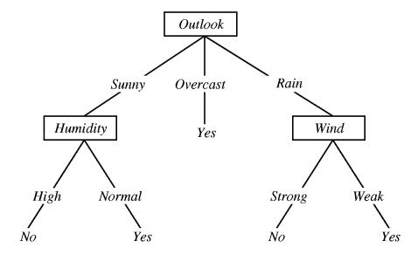
Decision tree classifier
what is the decision tree?
each node represents a feature(attribute)
each link(branch) represents a decision(rule)
each leaf represents an outcome(categorical or continues value).

Slide 5
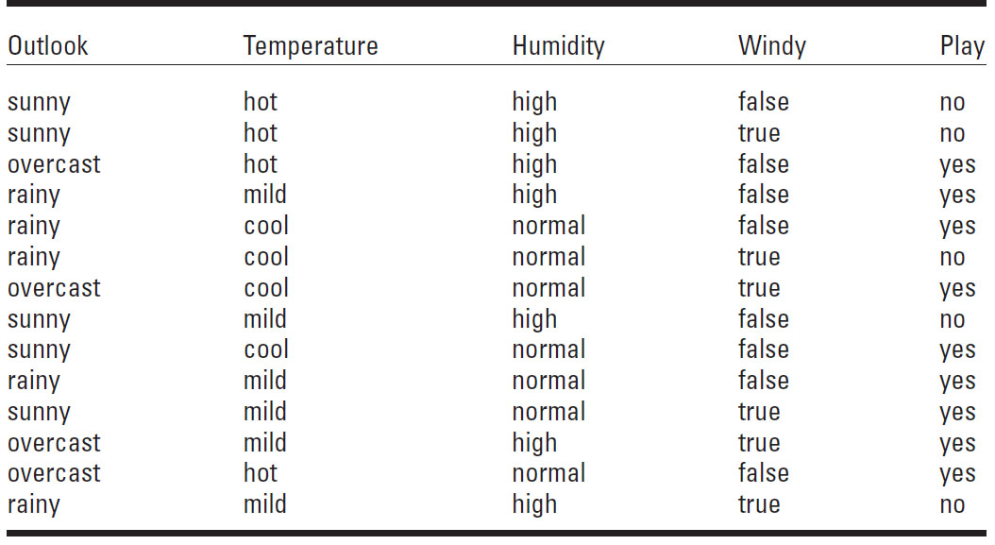

Slide 6
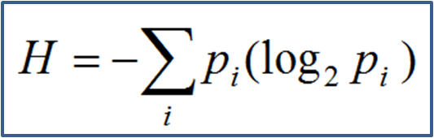
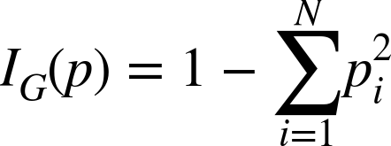
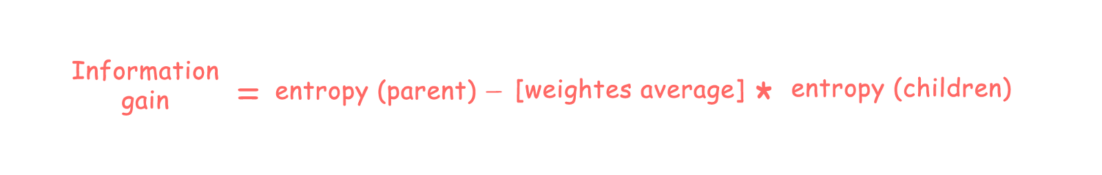
Entropy,gini impurity and information gain

Slide 7
How Decision Tree Works ?
How do we choose the best attribute?
use the attribute with the highest information gain to split the dataset
In the upcoming example splitting the dataset using the outlook attribute has given us the highest information gain hence we split using this attribute
We apply this recursively until we get to a particular depth to avoid overfitting .

Slide 8
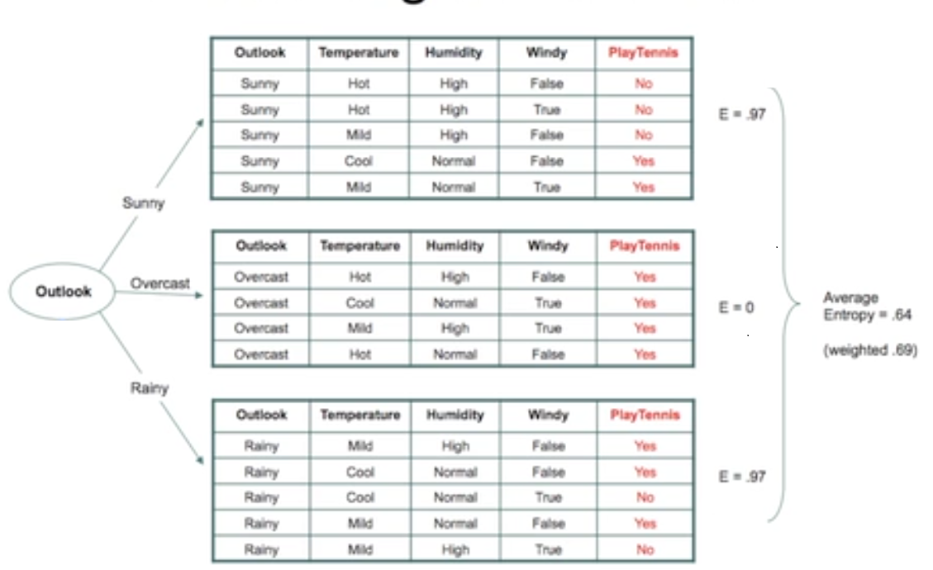

Slide 9
contd..

Slide 10
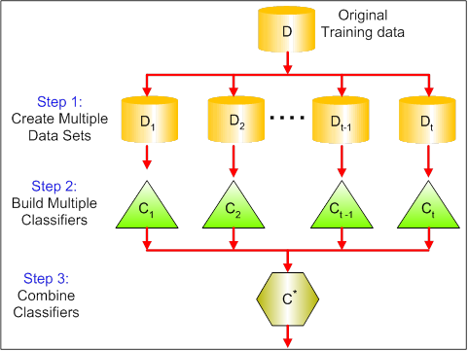
Random forests

Slide 11
contd..
Bagging =bootstrapping + aggregation
Row sampling and Column sampling
Using bootstrapping we build the base learners,each of the base learner is a decision tree which we train with datasets with same number of data points and features but the features need not be the same as they are taken randomly using column sampling .
The variance decreases as we increase the number of base learners.

Slide 12
Feature selection in random forests
Mean decrease impurity:When training a tree, it can be computed how much each feature decreases the weighted impurity in a tree. For a forest, the impurity decrease from each feature can be averaged and the features are ranked according to this measure.

Slide 13
Experimental Data Sets
4 kinds of Data sets :
Hel+DM+ ( 60 patients with double disease)
Hel- DM+ ( 60 patients with Helminth infected, Diabetes free)
Hel+DM- ( 60 patients with Helminth free, Diabetes infected)
Hel- DM- ( 60 patients free from both diseases)
Each datapoint have 50 features :
Adiponectin (pg/ml)
Neutrophils (%)
BMI
….

Slide 14
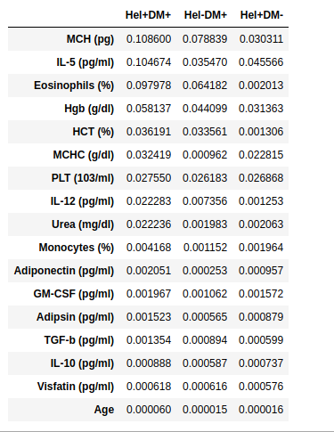
Result:
Features which have high score to predict Hel+DM+ case than Hel+DM-, Hel-DM+.

Slide 15
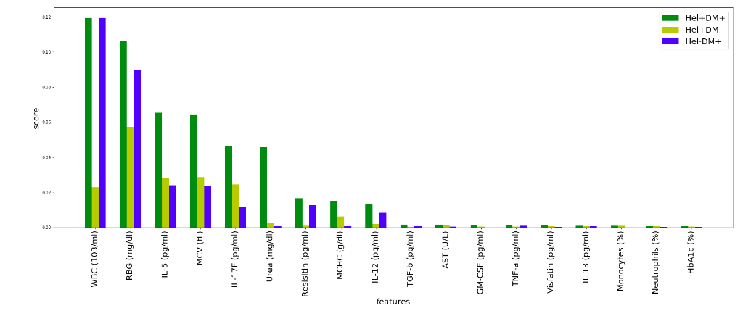
Result

Slide 16
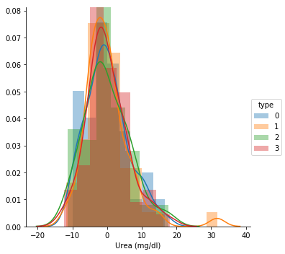
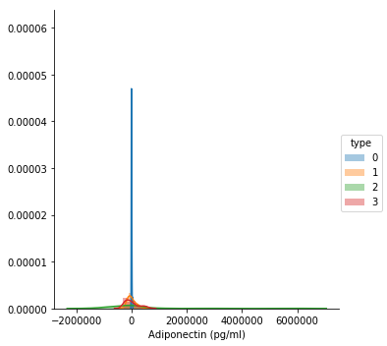
Univariate analysis

Slide 17
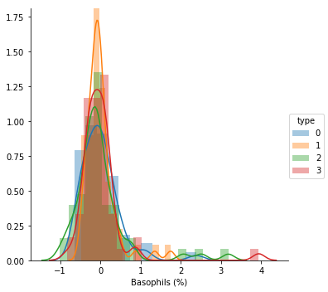
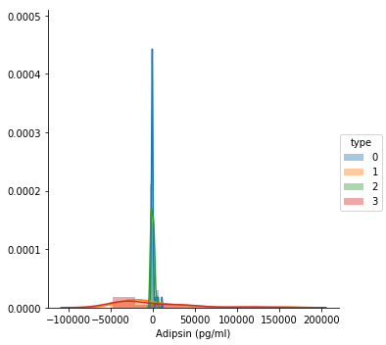
contd..

Slide 18
THANK YOU

